Slide 1
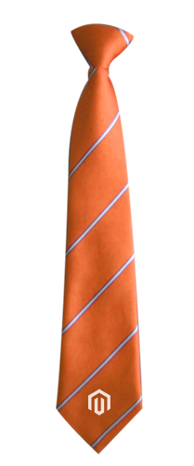
Sorry, your name again?!
Tadhg =
+
g
Just call me Tiger!

Slide 2


@TadhgBowe
“Success is the result of perfection, hard work, learning from failure, loyalty, and persistence.”
Colin Powell
Founded 1997. Based in Surrey UK.
100% Magento
100% Community
100% Believe in Father Christmas
Screen Pages
Technical Team Lead

Slide 3
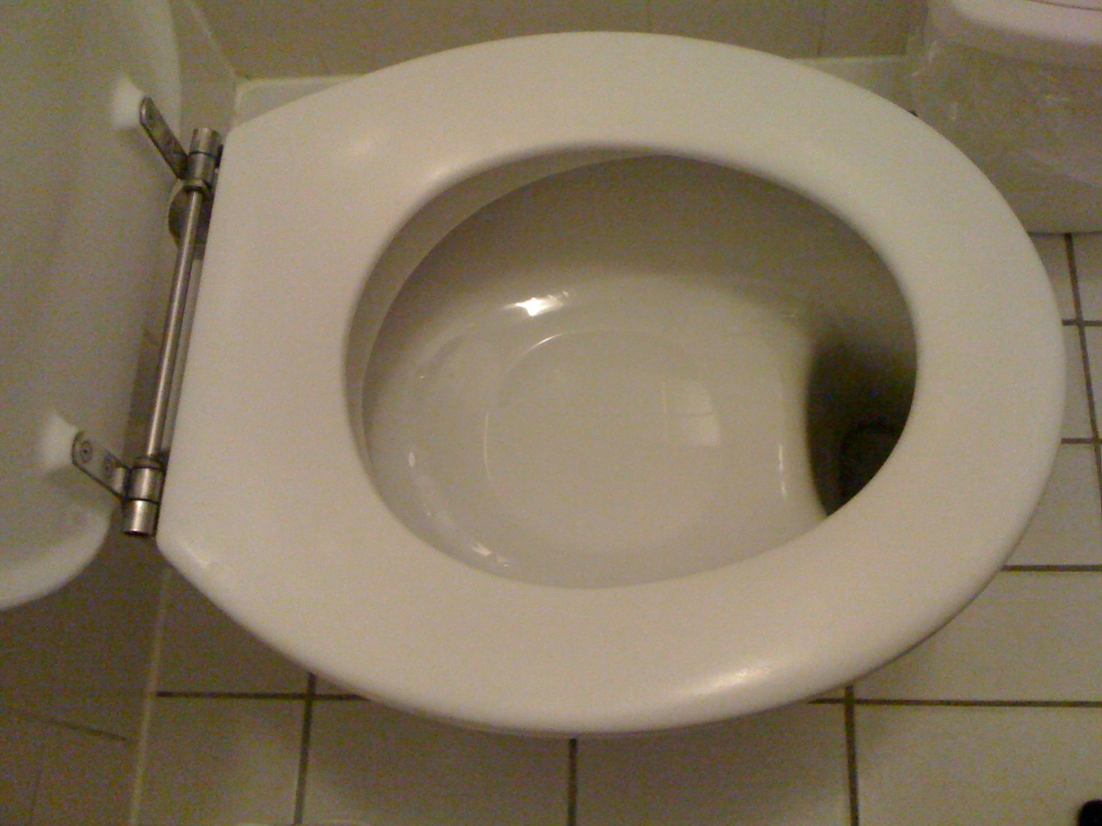
Before we start! ☺
FLASH BACK…
or is that
FLUSH BACK!
My first ever technical talk was 2 years ago on this very stage.
This was one of my first slides.
It’s funny because people often comment on the story I told (toilet humour).
When I ask them do you remember what the rest of the talk was about
they normally reply “Nope” - Haha! ☺

Slide 4
What’s the story then?
My Journey to becoming a
Magento Community Engineering
Contributor
Magento Community Engineering Team: Here to stay! Began in 2017 and is
growing all the time. They’re enjoying some tremendous success.
Contributor = Contribution: It’s not all about core code.
There are many ways to contribute: Help organise events, share knowledge online/offline,
networking by attending meetups/conferences or being active on social media.
Community: I love the Magento community. It’s as simple as that. The reason I’m here today
is because of the Magento community! I have met the best of people.
I have so many wonderful stories. Long may it continue.

Slide 5
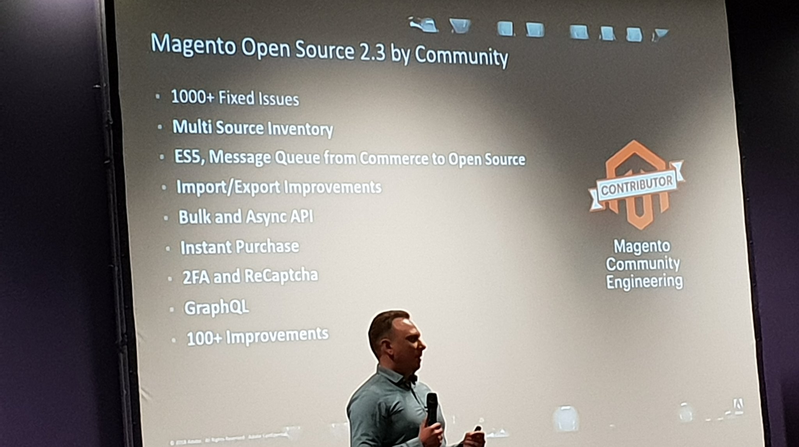
Impressive! Well done everyone.

Slide 6
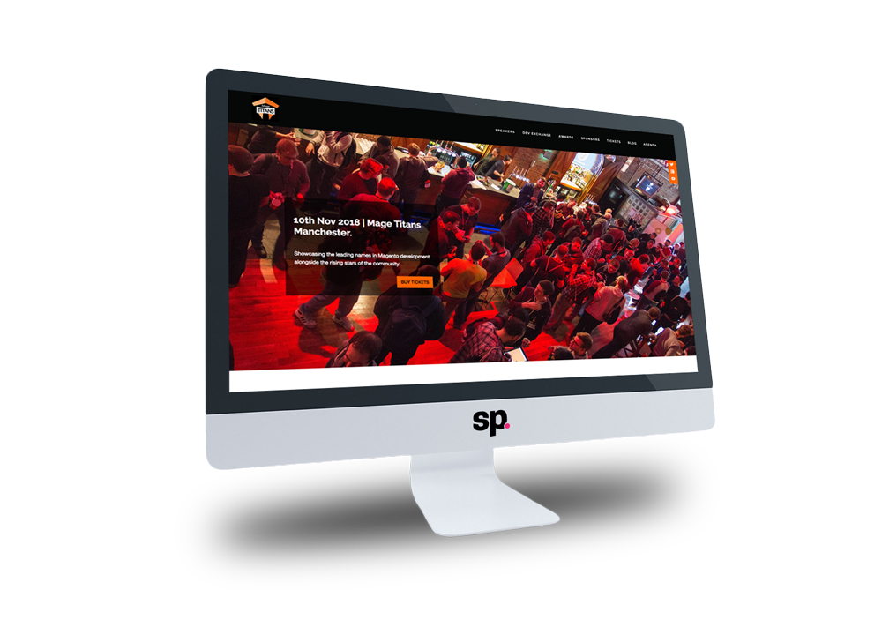
Contributing to the core:
First, my wee journey…
Where?
How?
How good did that feel?
WHY?
I attended my first developer conference in 2015 – Mage Titans Manchester.

Slide 7
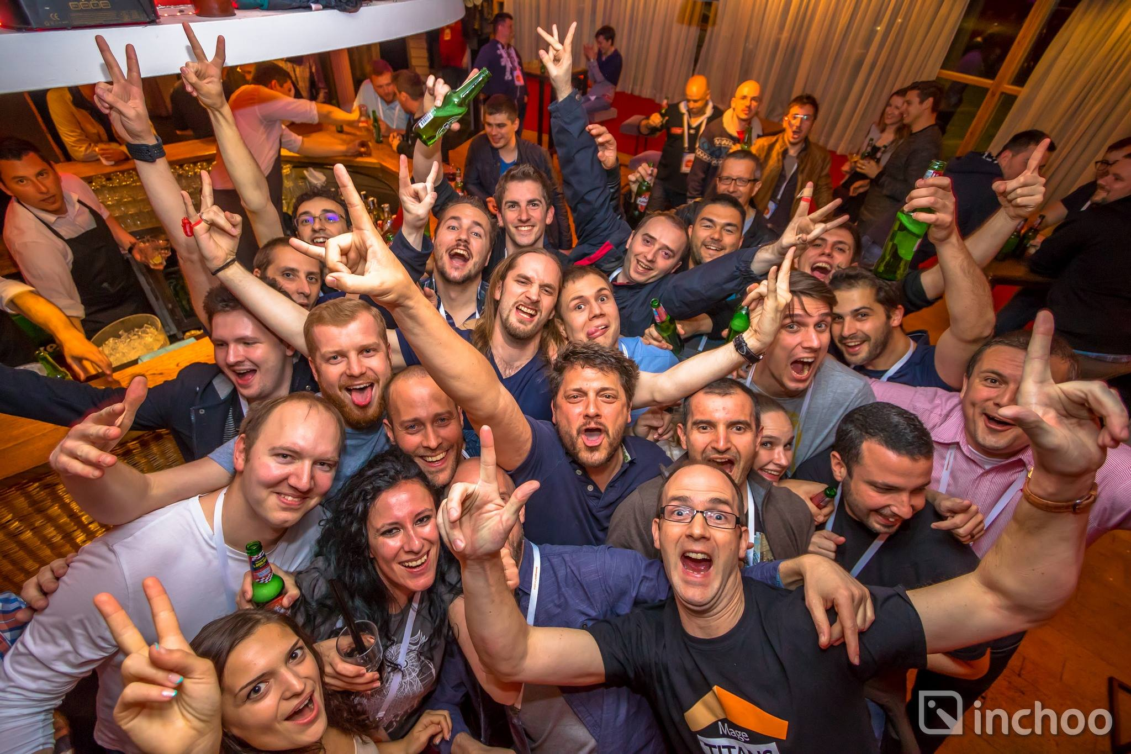
Dev Paradise 2016!
The Family Effect!
Dev Paradise in Croatia. INCHOO!! What a team!
I started meeting amazing people from across Europe and beyond.
We have a wonderful network of people.
How lucky we are.

Slide 8
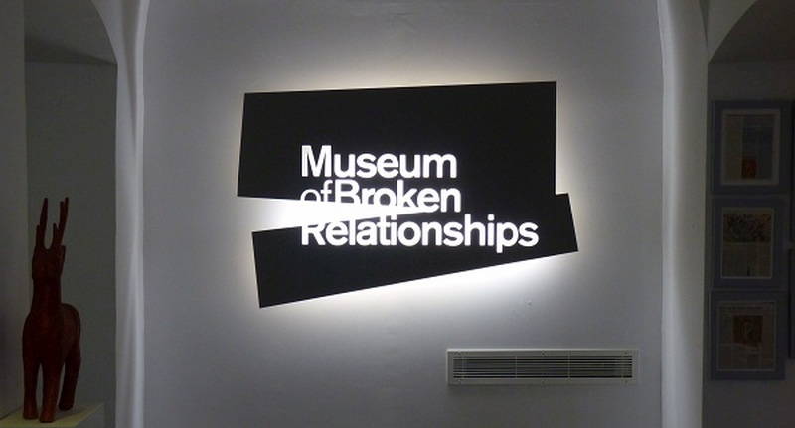
Moments like these…
When Magento 2 first launched I had a wee problem. At Dev Paradise I described my predicament similar to the above museum in Zagreb (BTW - I did actually visit and it was fascinating). After I said my piece very politely, I was quickly met by Max who assured me something was being done. This led me to believe:
These guys do care!
And they continue to care. They are human too. They have young families just like us.

Slide 9
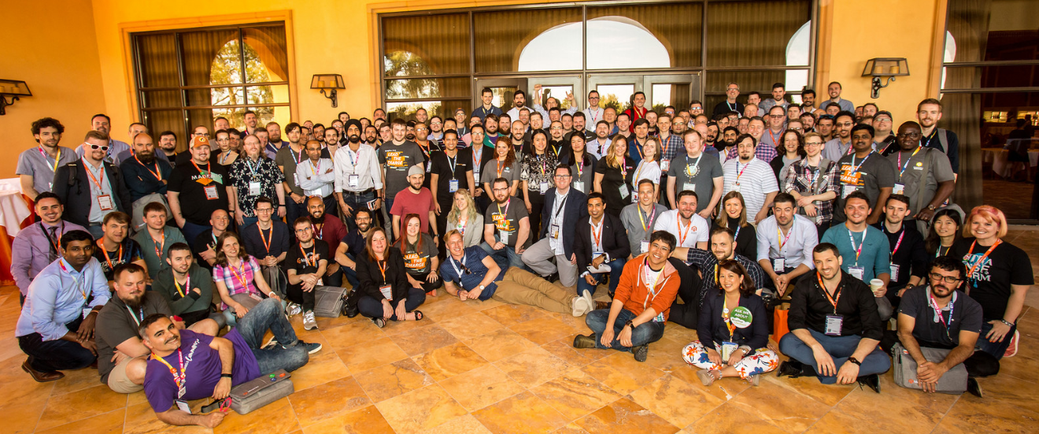
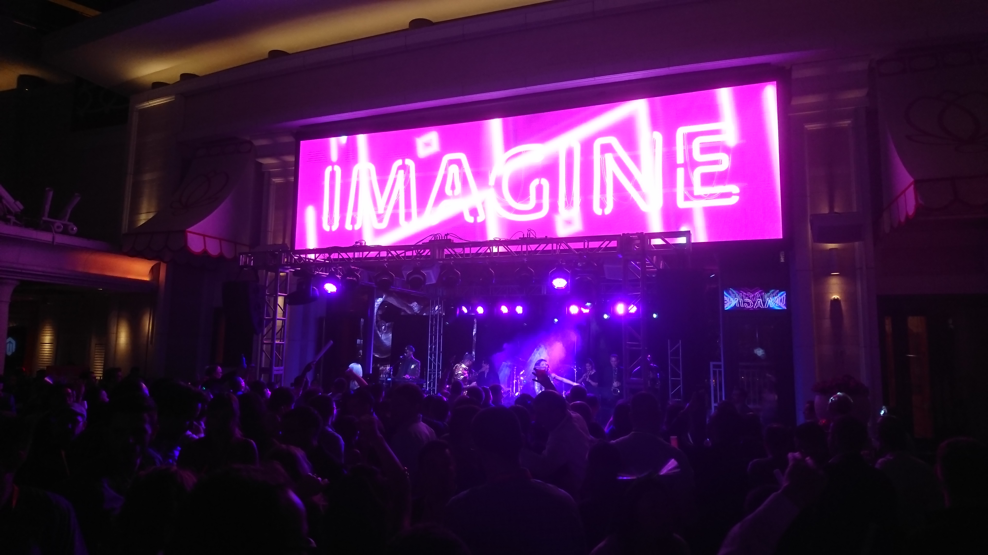
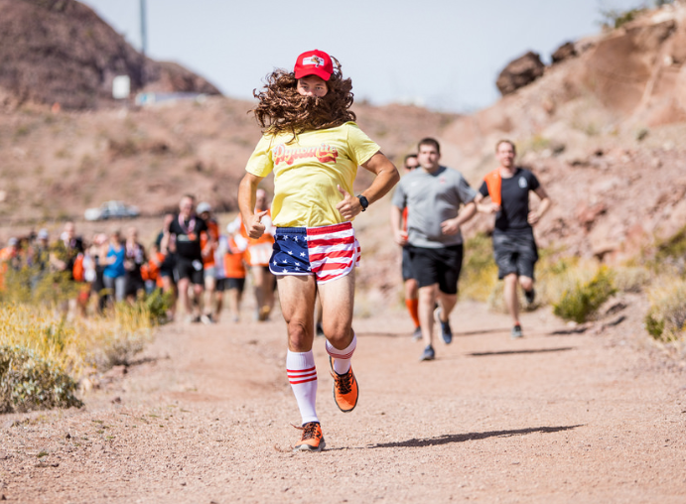
The journey continued… Imagine!
#DevExchange
Imagine 2018! If you haven’t been to Imagine and you get a chance… GO!
Personal highlights: The people, The Big Dam Run, The talks but especially the #DevExchange.

Slide 10
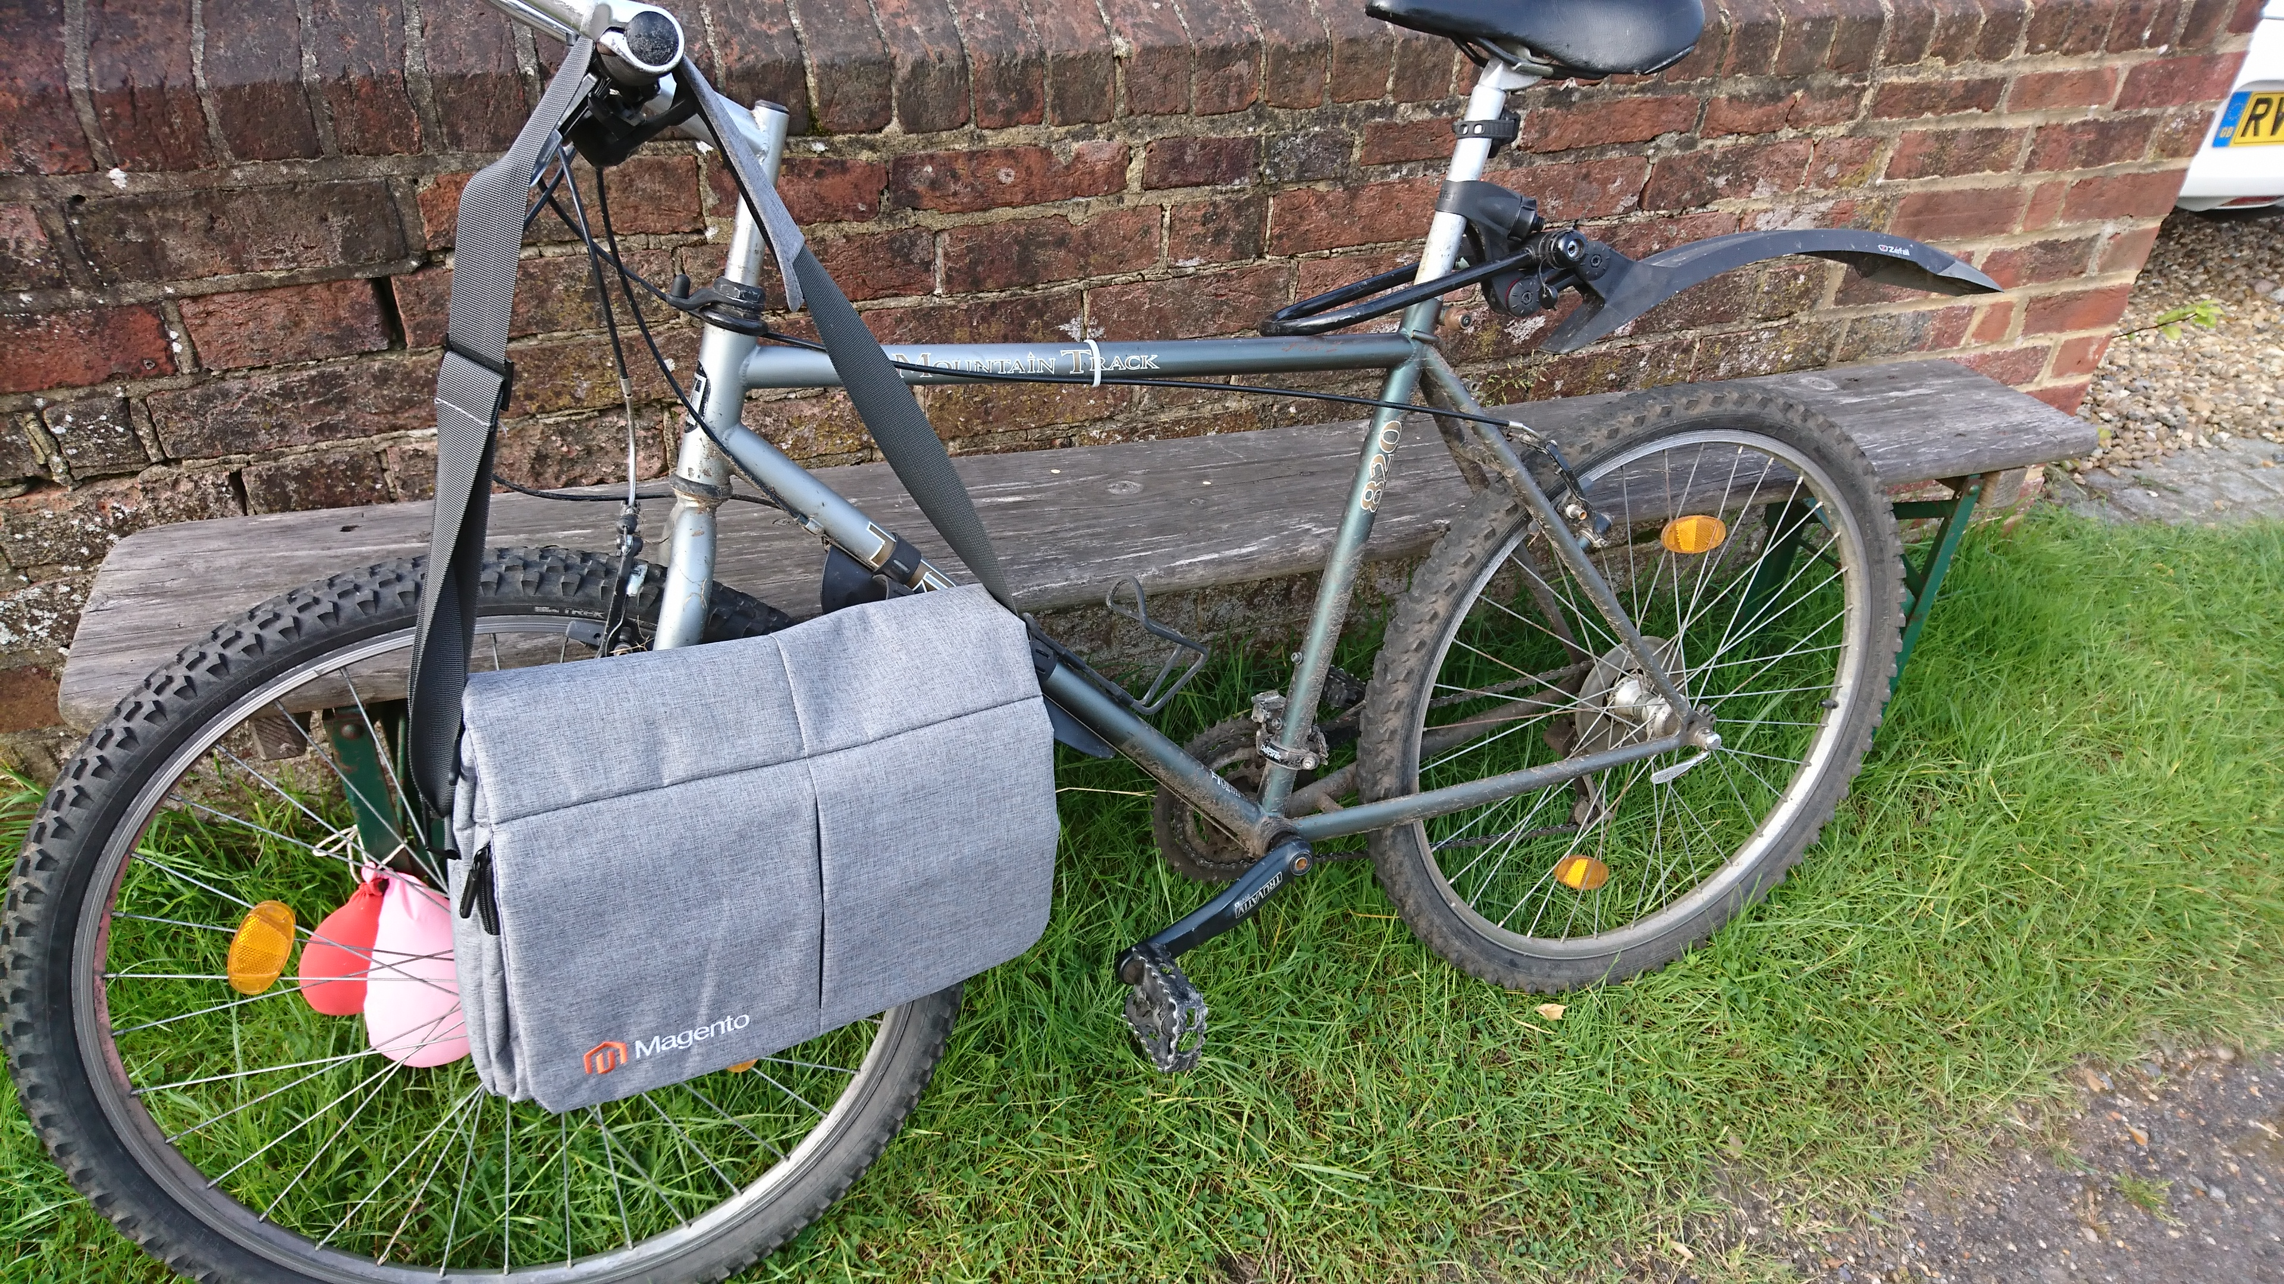
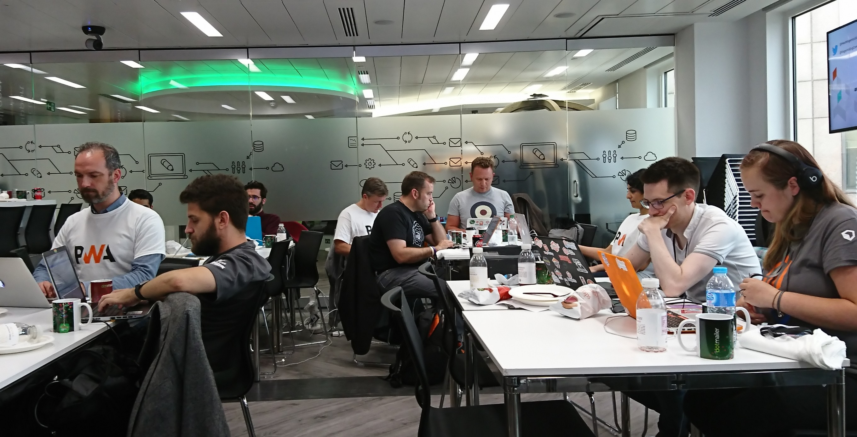


Contribution Day in London:
I’m going to tell you something for nothing!
Have you ever smelt Magento?! Ladies and gentlemen I could smell Magento that day. And I know what you’re thinking! No it didn’t smell of that. Oh no! It smelt sweet and beautiful ☺

Slide 11
Don’t be scared…
Never been to a contribution day before? Don’t worry. You’re in safe hands.
The Community Engineering team don’t bite!
Nobody is judging you. Nobody is looking down on you. It’s a fun day. I went in with no expectations. I came out with a GitHub case assigned to me! ☺
It’s actually quite educational. And it’s free!

Slide 12
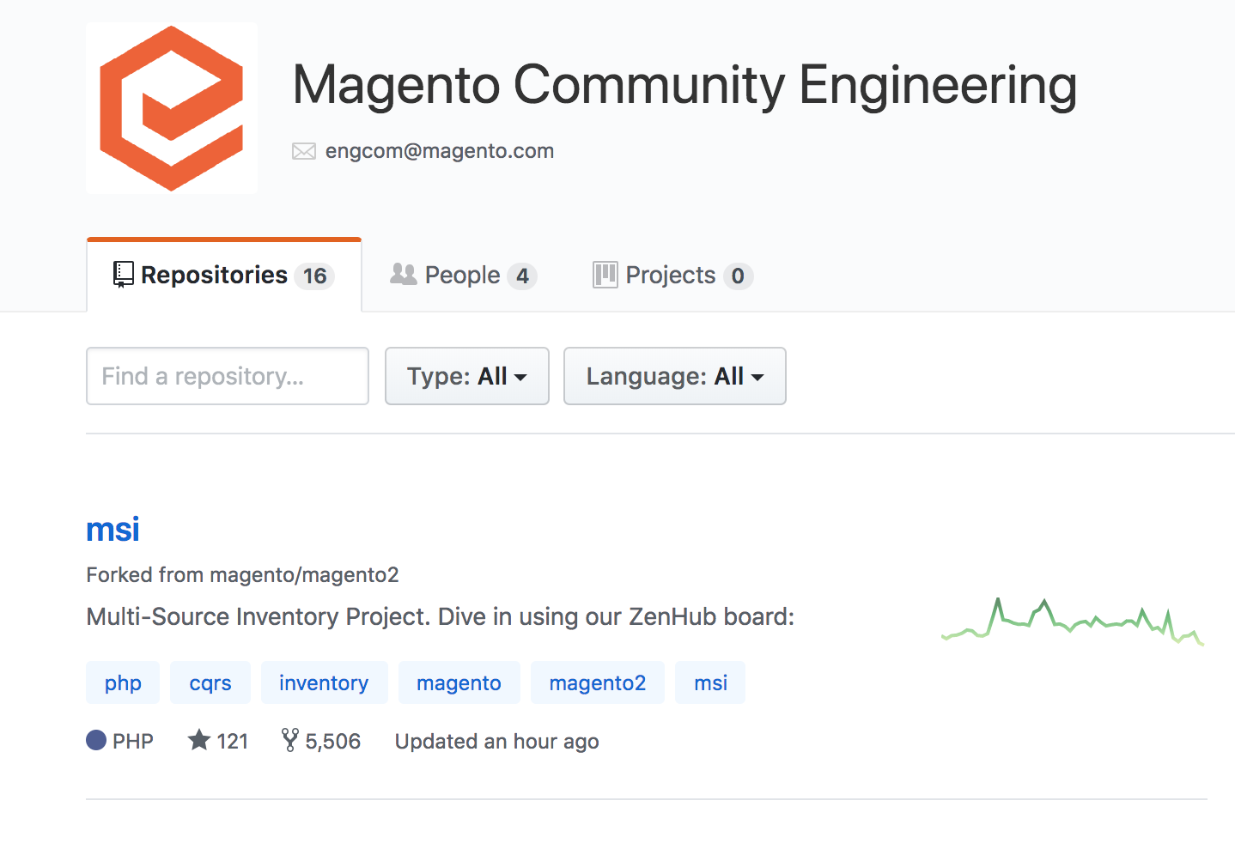
Get stuck in on Contribution Day:
We looked at issues / improvements linked to a small subset of repositories.
I became interested in the import-export-improvements repository.
Suddenly I started saying to myself: ”I can have a go at this”…and so I did!

Slide 13
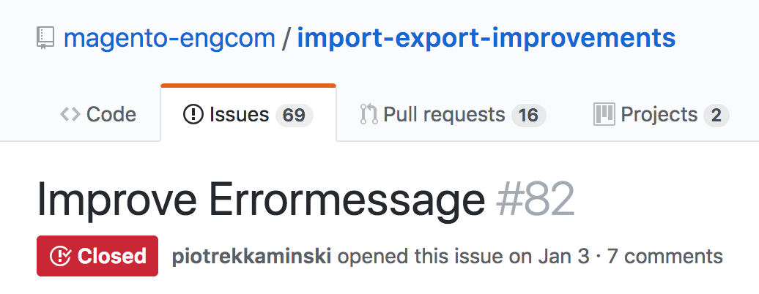
My first contribution pull request:
If the import detects that a configurable_variations attribute code is not super one the following error messages will be displayed…
Yawn! Boring to some but not to me. There’s an area that will suit most people. That’s the beauty of it.

Slide 14
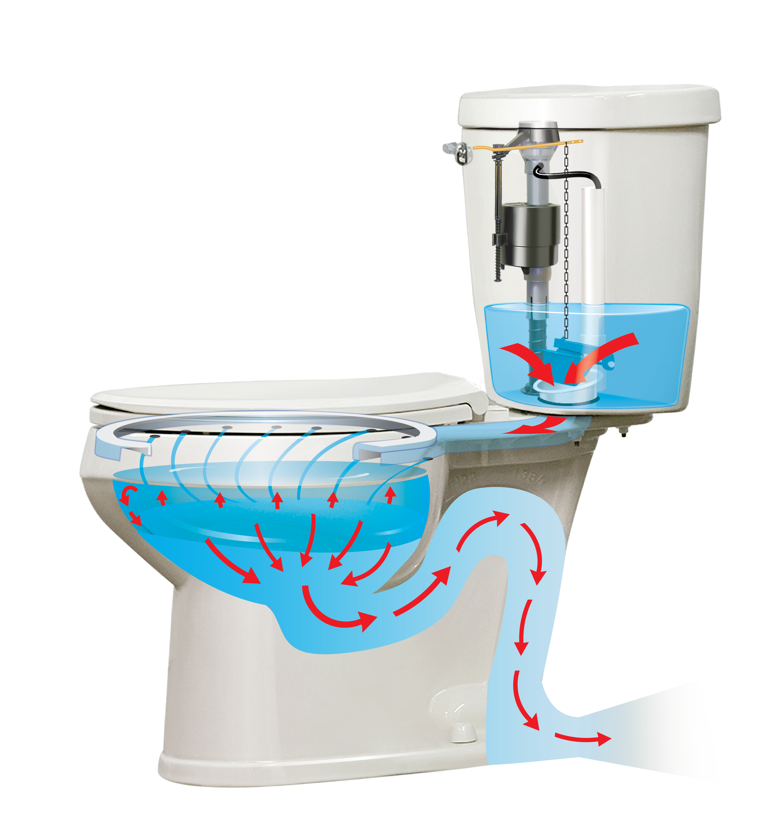
Contribution Flow:
Pull Requests
Core
Engineering
Team
Magento Core ☺

Slide 15
My first contribution pull request:
GITHUB account
Create a fork
Create a branch
Apply my code enhancements. Test!
GIT add, commit, GIT push.
DONE! ….well….

Slide 16
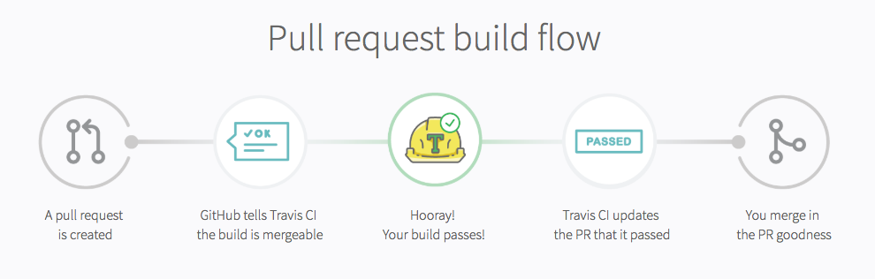
Not quite… Travis CI builder
FAILED ☹
CODE REVIEW
Example Fails:
1. PHP Code Sniffer detected 2 violations i.e. small code styling issues.
2. The method identifySuperAttributeError() has a Cyclomatic Complexity of 11.
The configured cyclomatic complexity threshold is 10. i.e. too much happening
in one function – break it into manageable chunks.
Finally: Code Review – A member of the engineering team may review your code. Good idea!

Slide 17
What happened next:
I joined a weekly catch up meeting online.
Took on some more cases in import-export-improvements.
Got involved in some interesting conversations / emails.
How many PRs have I submitted?
1
That one Pull Request took up over 15 hours of my time.
Half of that was office downtime. The other half was spent at home.
We’ll come back to this in a few moments.

Slide 18
The big question:
WHY?
*** I’m a developer. I was inquisitive. And as I found out, yes I could actually do it!
*** And yes it felt good. I actually felt important for a brief moment.
*** But most of all it’s all about the community. It’s all about open source.
If my little improvement helps somebody out there great!
It was the best 15 hours I’ve ever spent.

Slide 19
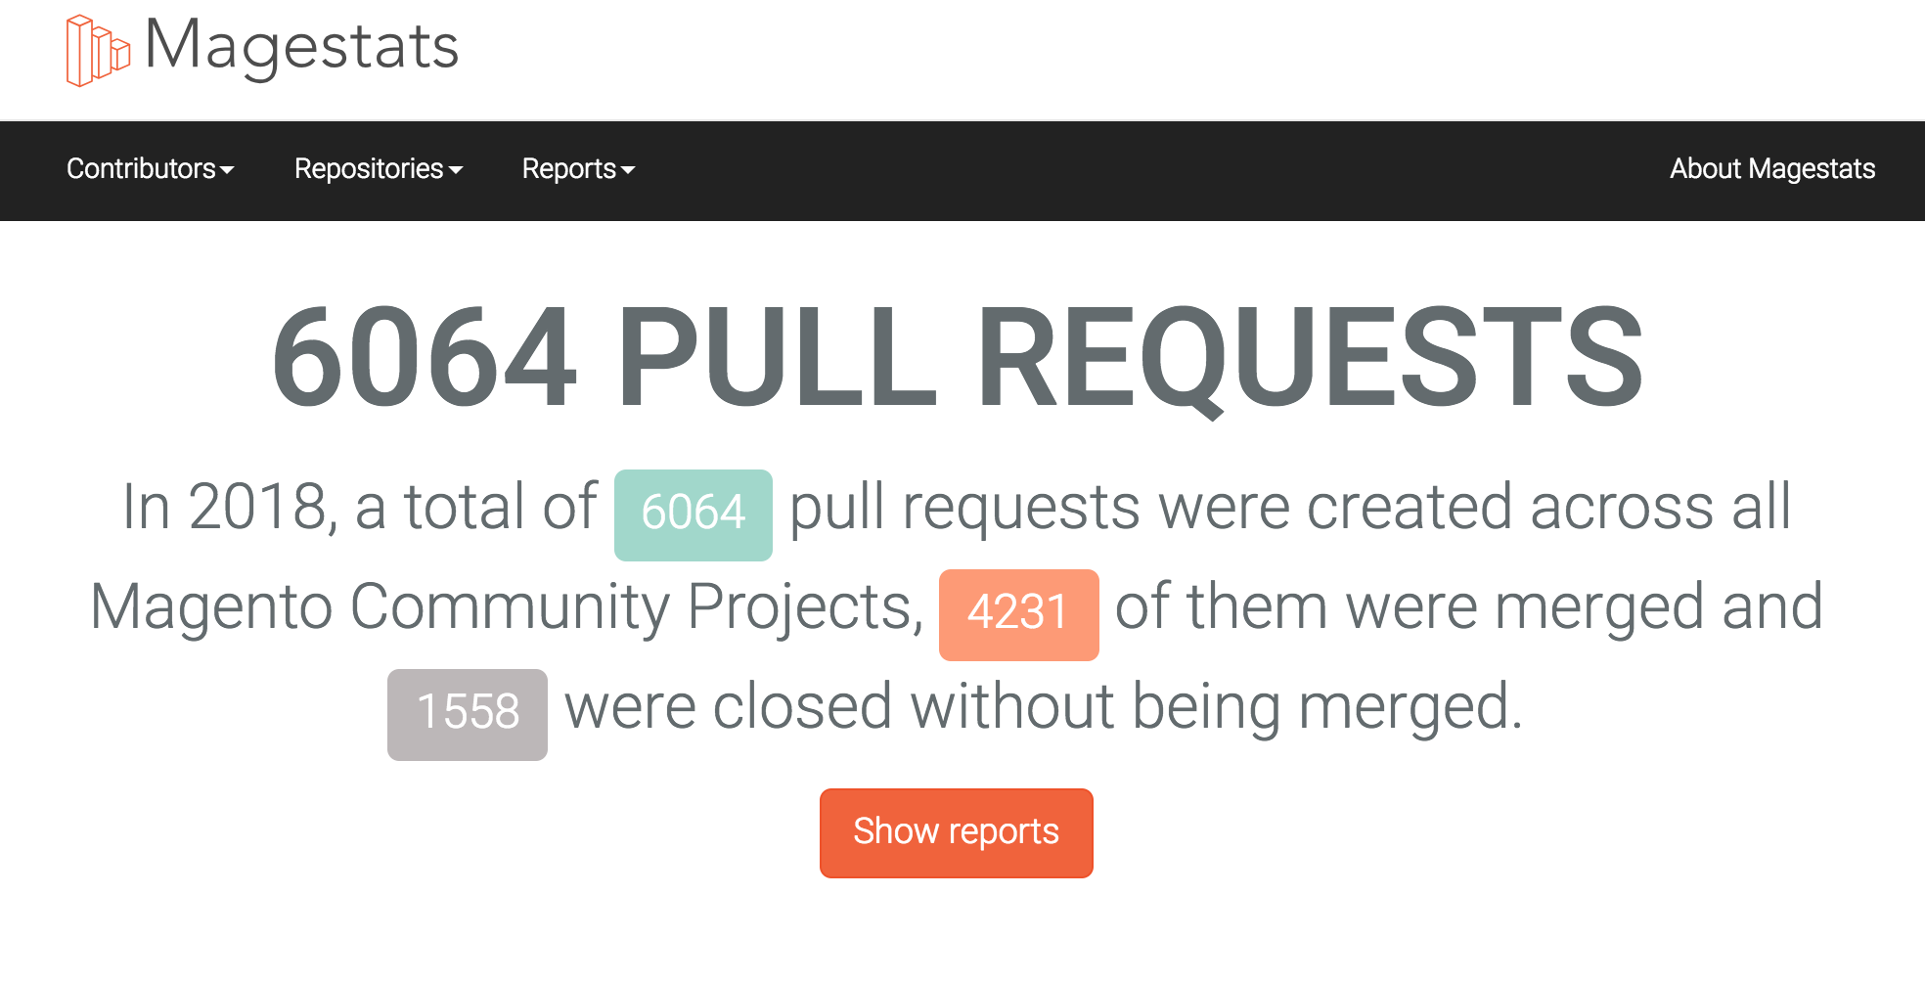
Impressive: magestats.net

Slide 20
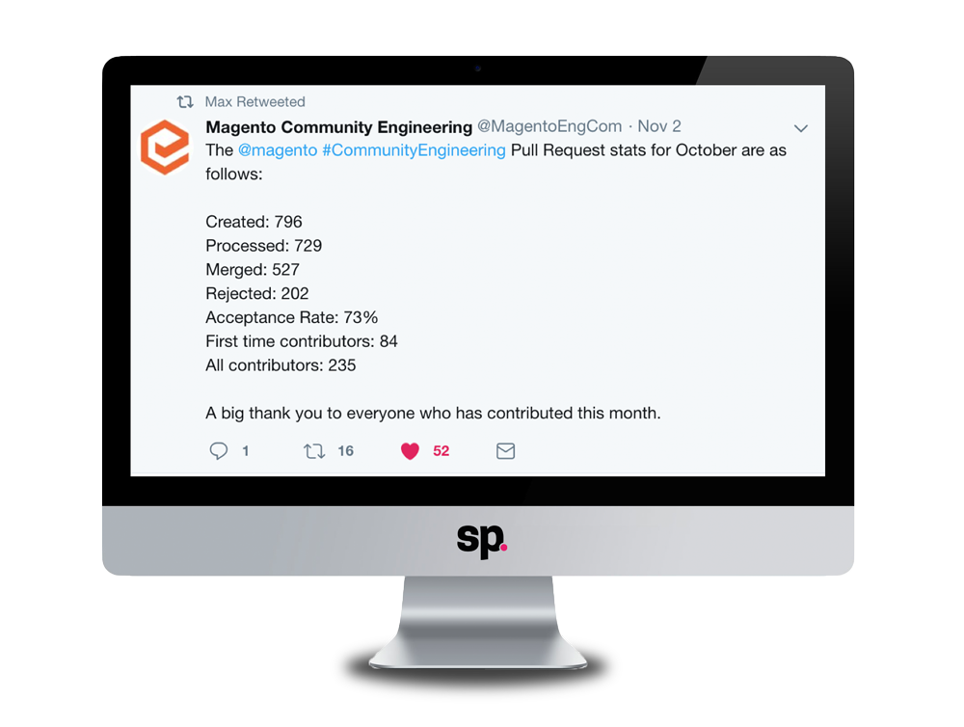
#SQUASHTOBERFEST 2018: Good job!

Slide 21
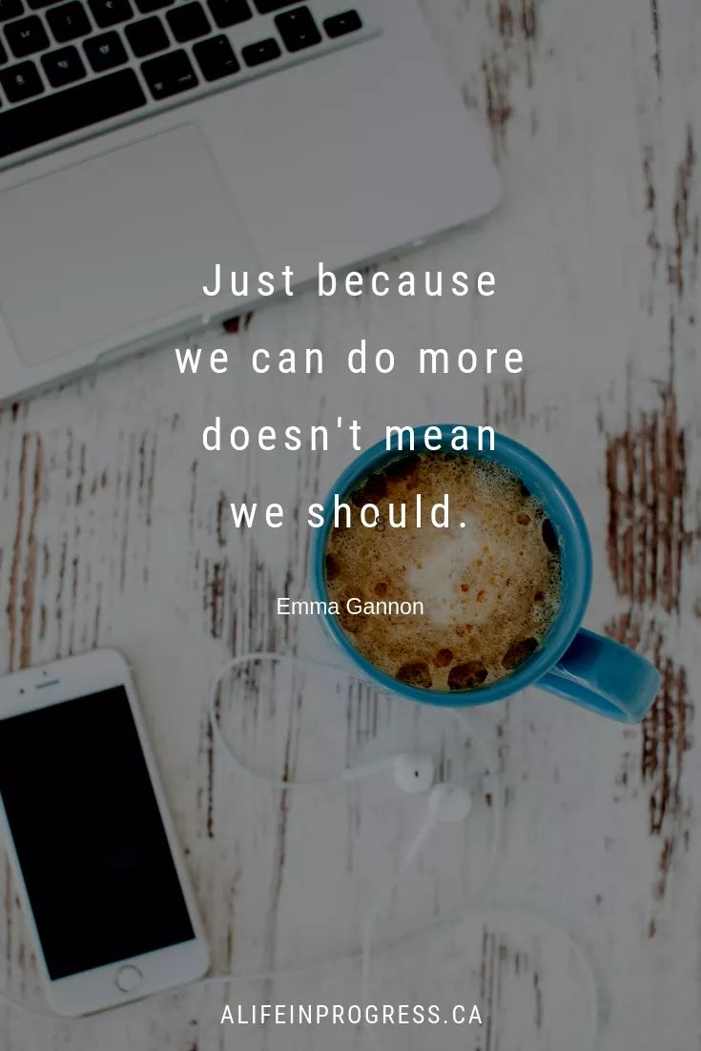
The bigger question:
Where did I find the time to contribute at home?
I had time to tackle some issues at home
because my wife was studying for her final exams.
But then she finished. We went on holidays. I had an operation.
Suddenly I felt bad not contributing. Almost anxious! -> STOP!
- Just because I could commit time then doesn’t mean
I have to always keep doing so!
- Know your limits. Magento should and will understand.
When I updated the engineering team they were brilliant about it.
Remember:
#mageMH
#NoMagentoSunday ☺

Slide 22
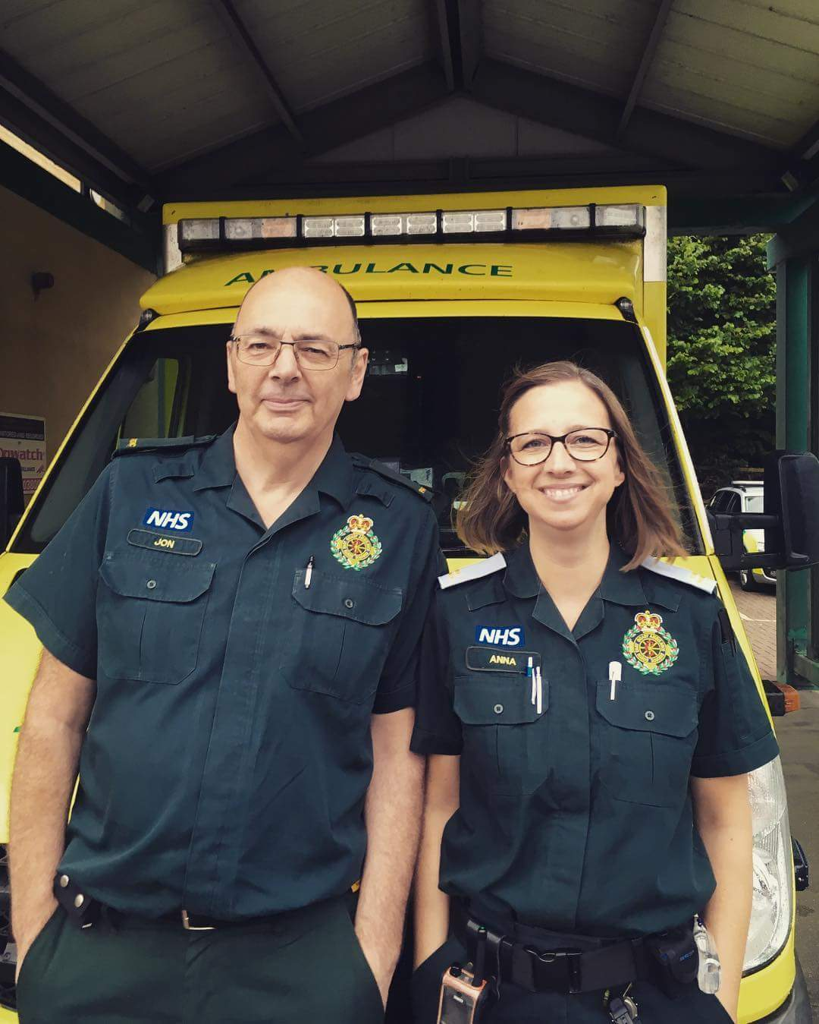
☺
This is my wife Anna with her mentor John. She has just qualified as a paramedic! It’s never too late to learn.
She just started her ambulance driver training. And….

Slide 23
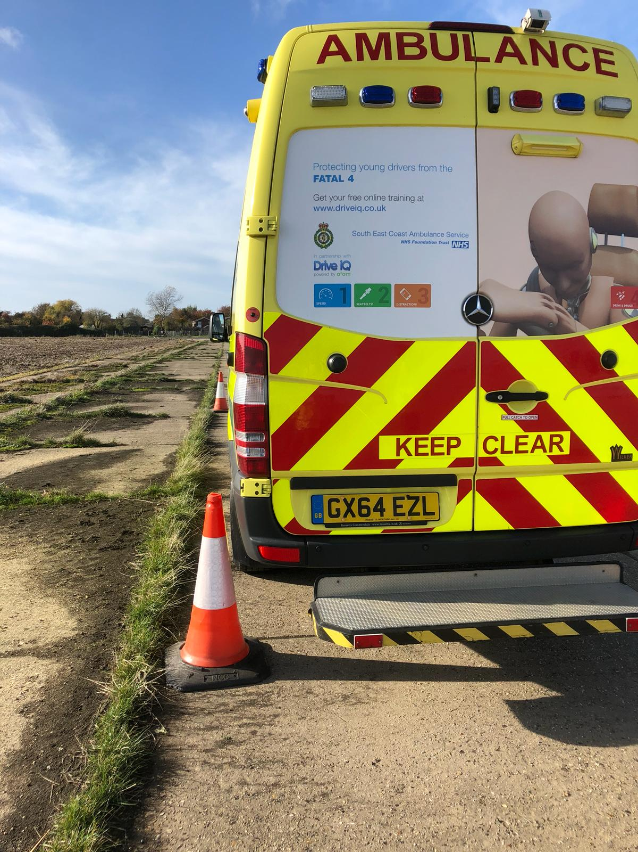
This is my PWA!
P ARKING
W ITH
A CCURACY
Well done Anna!

Slide 24
THANK YOU!
@TadhgBowe
SEE YOU SOON AGAIN MY FRIENDS!

Slide 25



