Slide 2
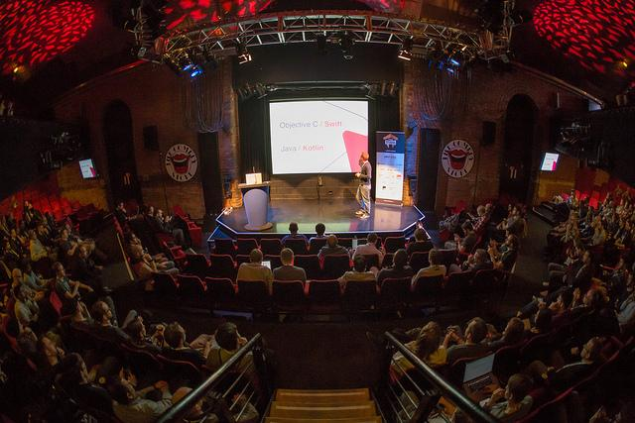
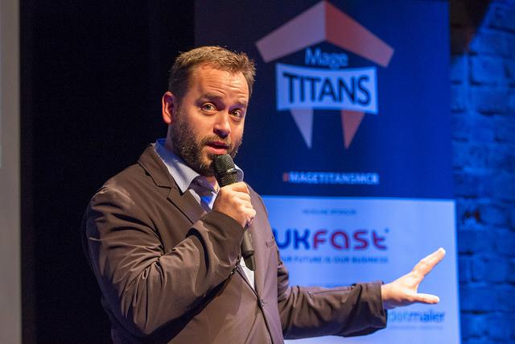
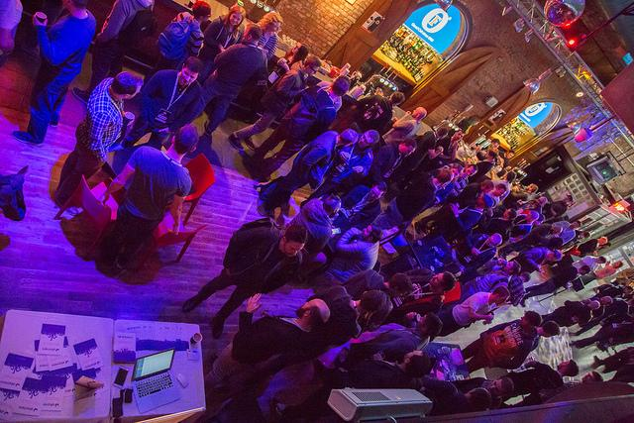
What is Mage Titans?
Mage Titans is a series of conferences that take place across the Globe for the Magento Developer Community. Mage Titans Manchester is to be held at The Comedy Store on Saturday, November 10th 2018.
The conference is now in its fifth year and is going from strength to strength.
Why Mage Titans?
Mage Titans is a partnership between the Magento Developer Community and Manchester Digital, the independent trade association for digital businesses in the North West.
The content for Mage Titan’s has been designed by Magento developers and it is the only solely developer focused conference in the UK. The aim of the conference is to offer affordable access to the world’s biggest and best thought leaders and innovators and offer a space for Magento developers to network and knowledge share with their peers.

Slide 3
Headline partner package
Being a headline partner at Mage Titans Manchester offers access to the Magento Developer Community here in Manchester
(1 available) £5,000 + VAT
Pre-event:
Logo on Manchester website (.co.uk)
Social media announcements (x5)
Opportunity to write technical blog for website and distribution on social media
Logo featured on all event correspondence (mailshots etc)
At the event:
Conference welcome remarks
Prominent positioning of logo on delegate badges
Opportunity to distribute flyers/gifts to delegates
Prominent exhibition space at event
Logo included on Mage Titans pop up banners
5 free delegate passes plus 2 free exhibitor passes
Logo on holding slides
Opportunity to write “thank you” message in post-event mailshot

Slide 4
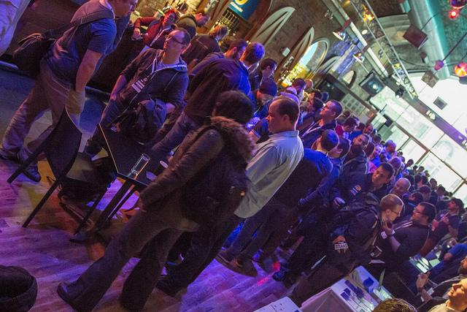
Gold partner package
(4 available) £2,000 + VAT
Pre-event:
Logo on website
Social media announcements (x4)
Opportunity to write technical blog for website
Logo featured on all event correspondence (such as mailshots)
At the event:
Logo on delegate badges
Logo on holding slides
Logo included on Mage Titans pop up banners
Opportunity to distribute flyers/gifts to delegates
Exhibition space at event
4 free delegate passes

Slide 5
Silver partner package
(4 available) £750 + VAT
Logo on website
Social media announcements (x3)
3 free delegate passes
Lunch partner package
(4 available) £500 + VAT
Logo on website
Social media announcements (x2)
2 free delegate passes
Community partner package
(4 available) £250 + VAT
Logo on website
Social media announcements (x1)
1 free delegate passe

Slide 6
Mage Titans Awards
This year we are excited to announce the return of our Mage Titans Innovation Awards. The awards are a celebration of the excellent Magento work currently taking place and provide an independant opportunity for entrants to showcase their best work in front of a host of Magento masters from around the world.
Sponsoring an award category puts your business at the forefront of the Magento community and provides a unique platform for you to position your brand. We have a number of categories for you to choose from including:
Innovation award
Best B2B Magento 2 site
Best B2C
Best migration award
Favourite talk of the day
Rising star award
Hall of fame award

Slide 7
Awards & after party headline partner package
(2 available) £2,000 + VAT
Pre-event:
Logo on website
Social media announcements (x5)
Opportunity to write technical blog for website
Logo featured on all event correspondence (such as mailshots)
At the event:
Logo on delegate badges
Logo on holding slides
Logo included on Mage Titans pop up banners
Opportunity to distribute flyers/gifts to delegates at the awards & after party
Exhibition space at the awards & afterparty
4 free delegate passes to the conference
Additional 3 places to the awards & afterparty
Branding at the awards & after party venue

Slide 8
Awards category partner package
(7 available) £500 + VAT
Pre-event:
Logo on website
Social media announcements (x3)
Opportunity to write technical blog for website
Logo featured on all event correspondence (such as mailshots)
At the event:
Opportunity to distribute flyers/gifts to delegates at the awards & after party
Present your category award
2 free delegate passes to the conference
Additional 2 places to the awards & afterparty
Branding at the awards & after party venue

Slide 9
Dev Exchange partner package
The Dev Exchange is a popular collaboration event held on the Friday night before the main event,
it gives the opportunity for developers to connect and discuss pre-nominated topics.
(1 available) £1500 + VAT
Pre-event:
Logo on website
Social media announcements (x4)
Opportunity to write technical blog for website
Logo featured on all event correspondence (such as mailshots)
At the event:
Dev Exchange welcome remarks
Opportunity to distribute flyers/gifts to delegates at the Dev Exchange
Exhibition space at Dev Exchange
4 free delegate passes to the conference
Opportunity to write “thank you” message in post-event mailshot to Dev Exchange attendees

Slide 10
Contact us
To discuss any of our sponsorship opportunities further, or if you want something tailor made to suit your budget, please contact Helen Kirkland, Events Manager at Manchester Digital on helen@manchesterdigital.com

